Slide 1
Quantum phase estimation algorithm

Slide 2


Slide 3

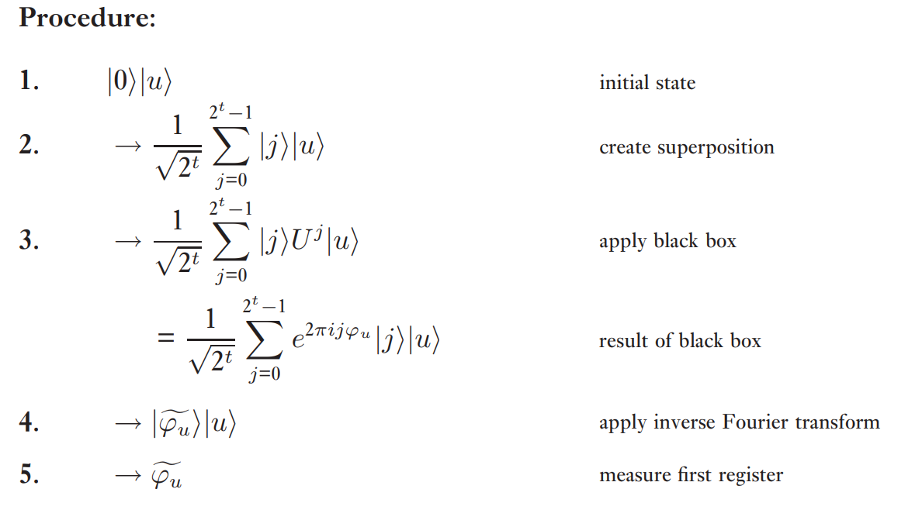

Slide 4



Slide 5
